Slide 1


Slide 2

Brief Introduction
Tanuj Nigam is a data scientist with 5+ years of professional experience in the area of data science. He is well versed with advance analytics tools and technologies including Deep learning, Blockchain, MLOPS etc. Apart from his work he is a visiting faculty at multiple data science institutes. His current interest includes use of AI/ML to build Quants based model for stock markets.
Linkedin : https://www.linkedin.com/in/tanuj-nigam-a4748375/

Slide 3
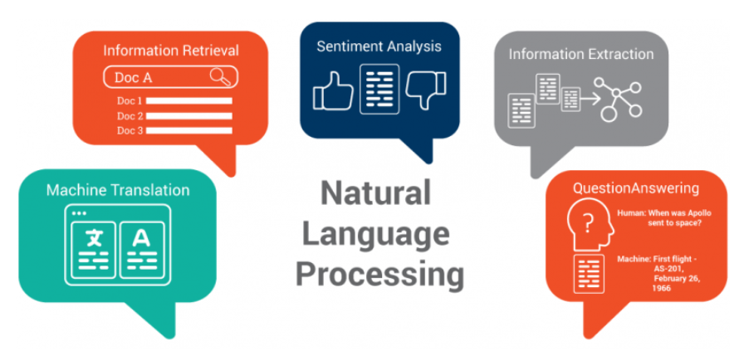
Topics in NLP
Machine Translation : Translate text or speech from one language to another
Information Retrieval : deals with the storage, retrieval and evaluation of information from document repositories
Sentiment Analysis : procedure used to determine if a chunk of text is positive, negative or neutral
Information Extraction: Text data contains a lot of information but not all of it will be important to us. The process of looking for names of entities, places, date of birth of individuals etc.
Question Answering : systems that automatically answer questions posed by humans in a natural language

Slide 4
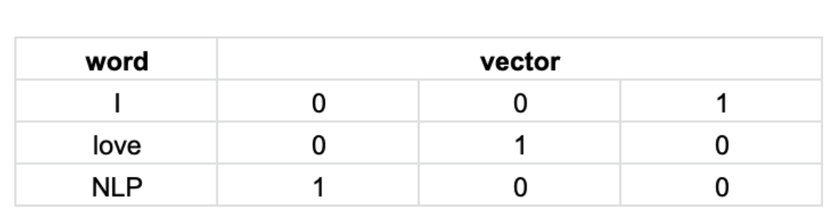
One-hot vector encodings
Representation of words as a vector — array of vocabulary size
Each word is represented by either 1 or 0
No context information is present, Matrix is very sparse

Slide 5
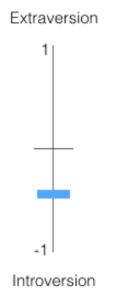
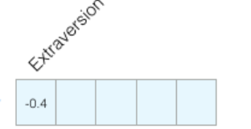
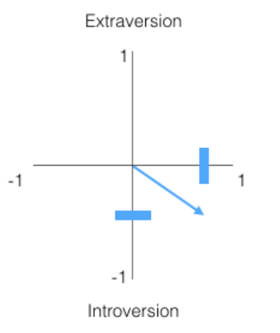
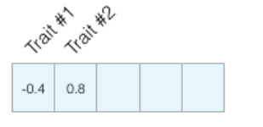
Word2Vec
On a scale of -1 to 1 how introverted/extraverted are you (where -1 is the most introverted, and 1 is the most extraverted)?
Imagine I’ve scored -0.4 as my introversion/extraversion score. we can plot that in this way:
Let’s add another dimension – the score of one other trait.

Slide 6
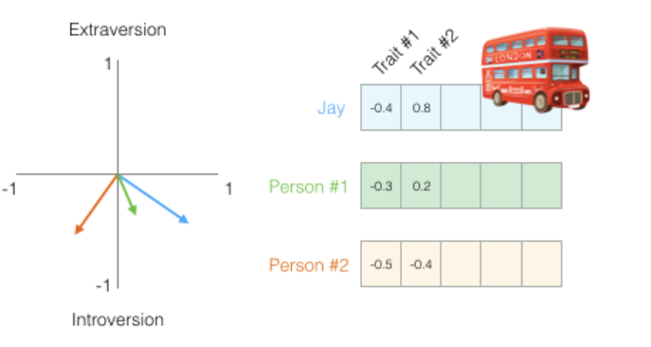
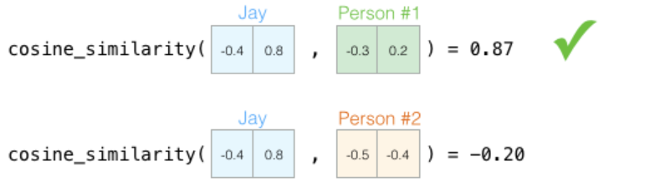
Word2Vec
Imagine I got hit by a red Bus and I need to be replaced by someone with a similar personality.
Which of the two people is more similar to me?
Common way to calculate a similarity score is cosine similarity

Slide 7
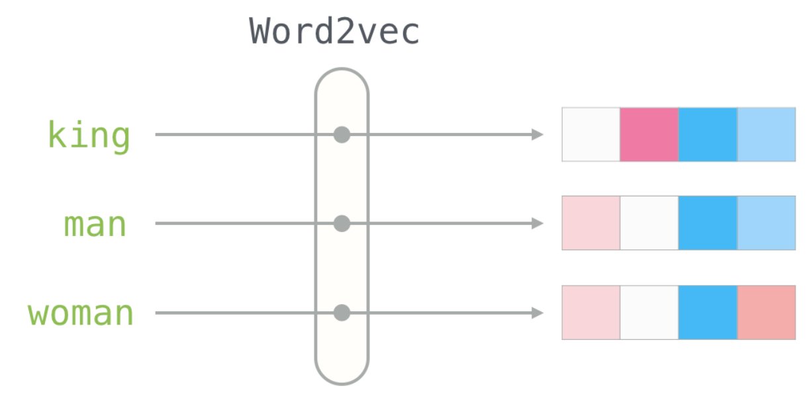
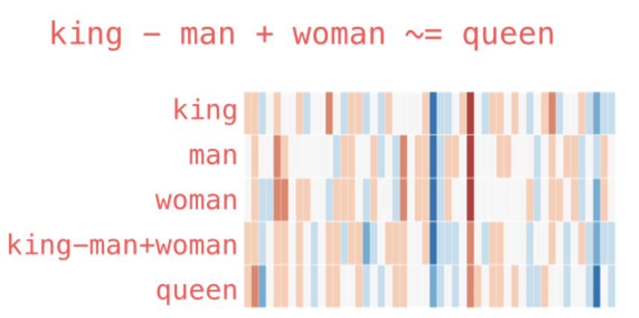
Word Embeddings
Each word can be represented by a Word Vector
Can we visualize this analogy

Slide 8
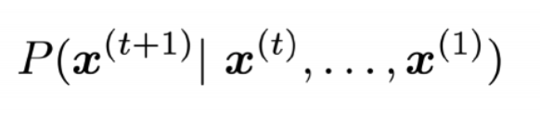
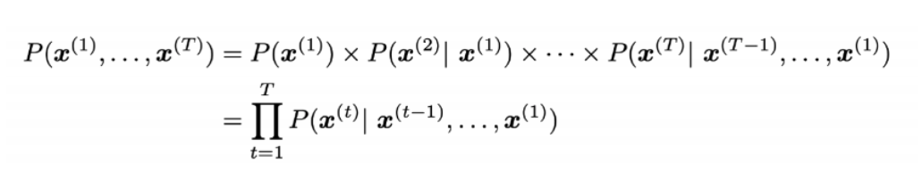
Language Models
A statistical language model is a probability distribution over sequences of words.
Language model is used to capture and predict the relationships between words across a sentence or a document.
Fundamentally, the language model predicts the conditional probability distribution for the next word in a sentence, given by:-
The probability of the occurrence of a sentence is given by

Slide 9
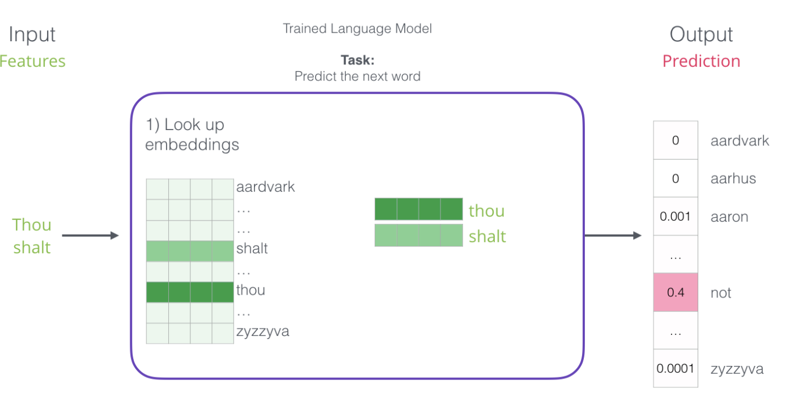
Language Models

Slide 10
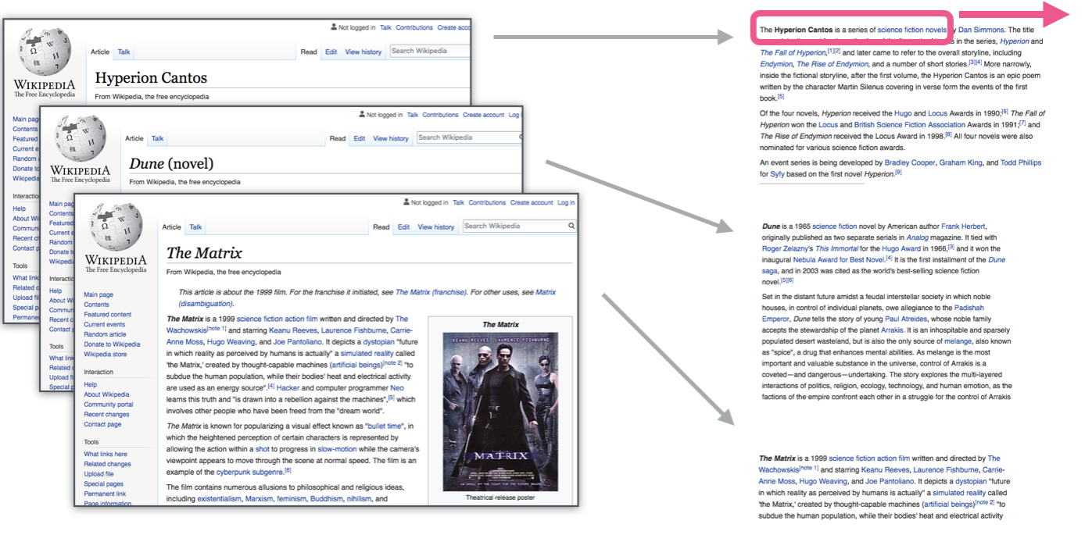
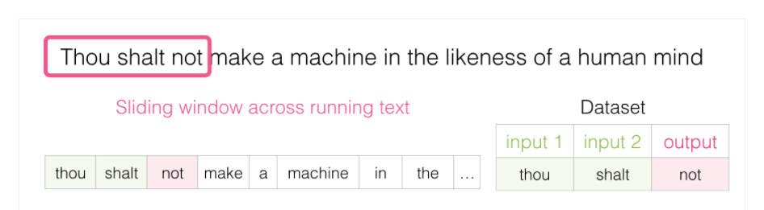
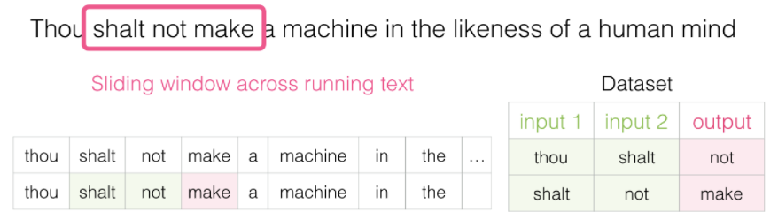
Data Required
Language models have a huge advantage over most other machine learning models in terms of data
We are able to train them on running text – which we have in abundance
Generate a dataset that we use to train a model using sliding
approach

Slide 11
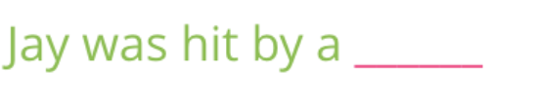

Better way of learning
Fill in the blank
What if I gave you one more piece of information – a word after the blank, would that change your answer?
Look Both ways

Slide 12
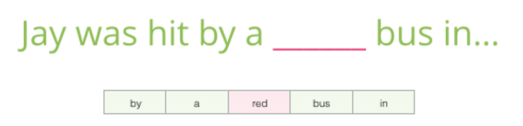
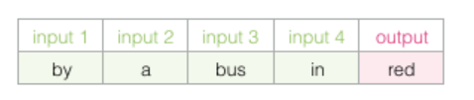
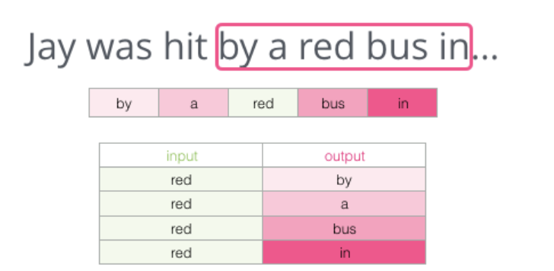
Training Approach
Instead of only looking two words before the target word, we can also look at two words after it.
The dataset we’re virtually building and training the model against would look like this
Tries to guess neighboring words using the current word.
CBOW
SkipGram

Slide 13
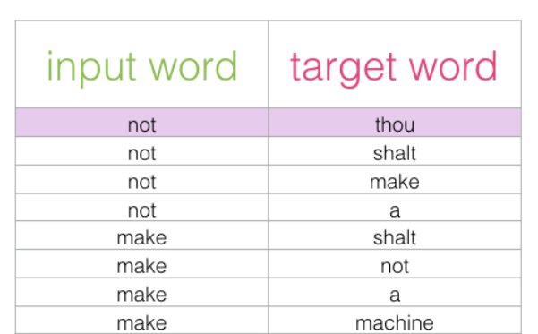
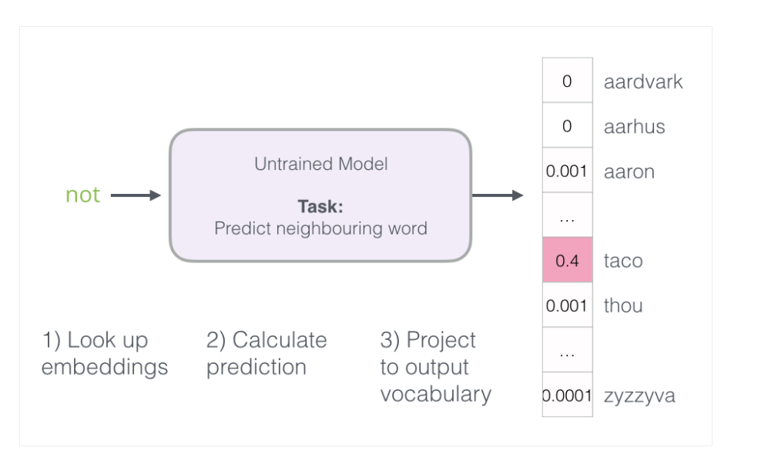
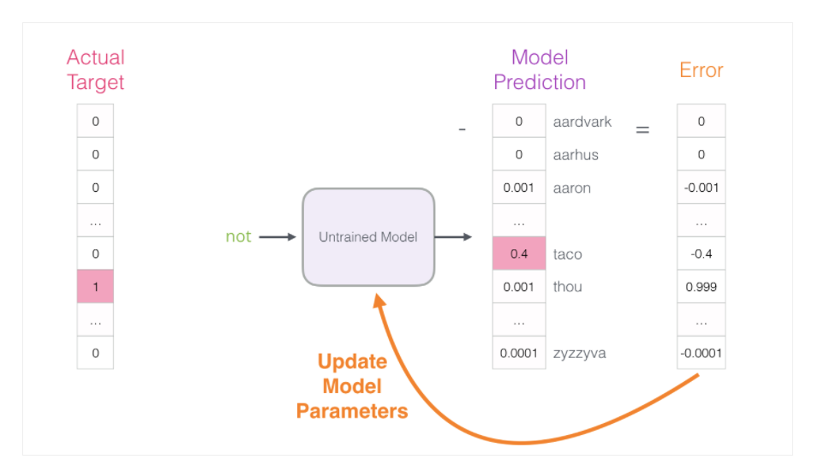
Training Approach
Let’s have skipgram training dataset that we extracted from existing text
Pass first Sample of data as input to the model to predict next word
Error vector can now be used to update the model so the next time, it’s a little
more likely to guess thou, when it gets not as input
3rd step is very expensive from a computational point of view – especially
knowing that we will do it once for every training sample in our dataset

Slide 14
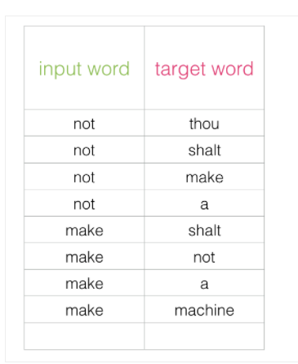
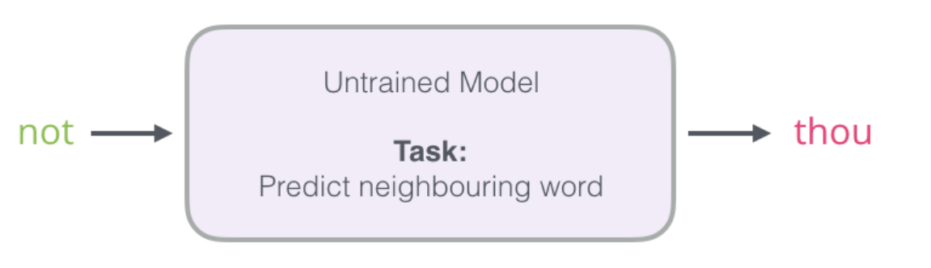
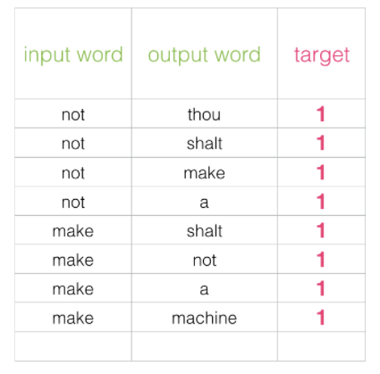
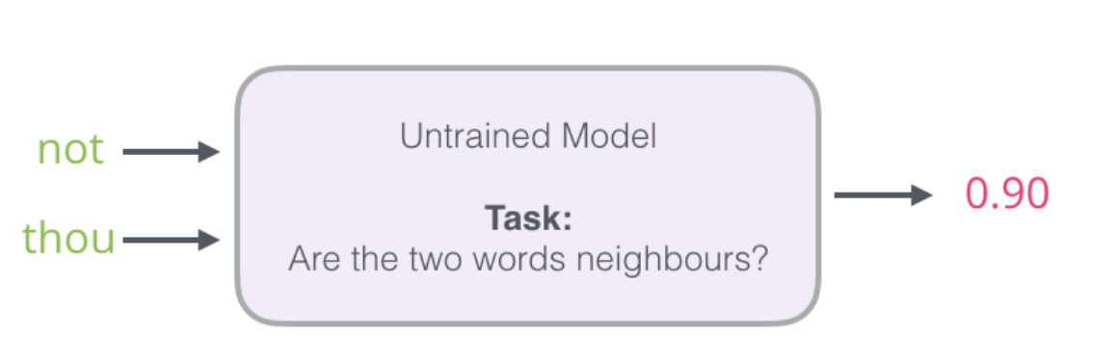
Negative Sampling
Change from:
Change to:

Slide 15
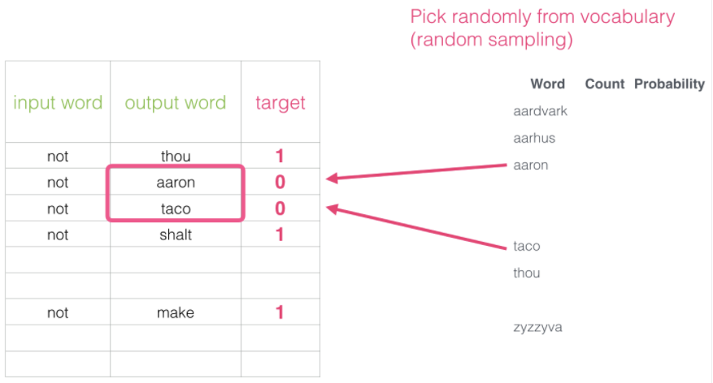
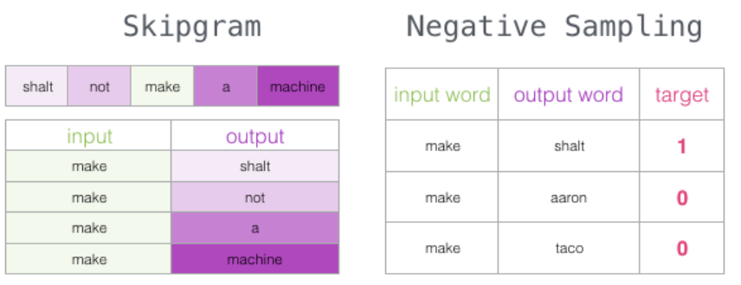
Negative Sampling
Need to introduce negative samples to our dataset – samples of words that are not neighbors
Model needs to return 0 for those samples
Skipgram with Negative Sampling

Slide 16
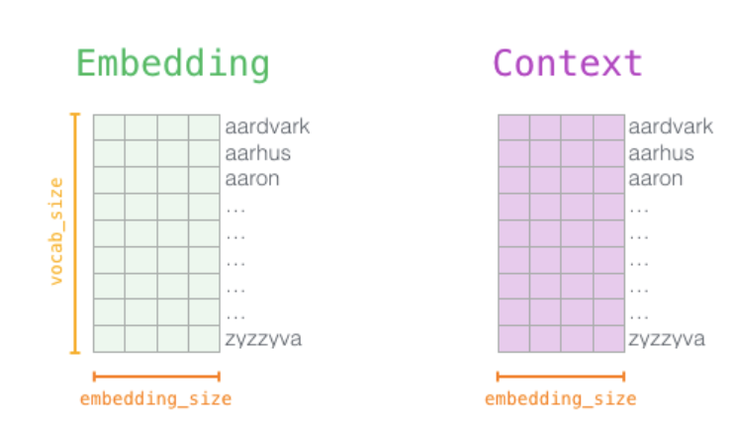
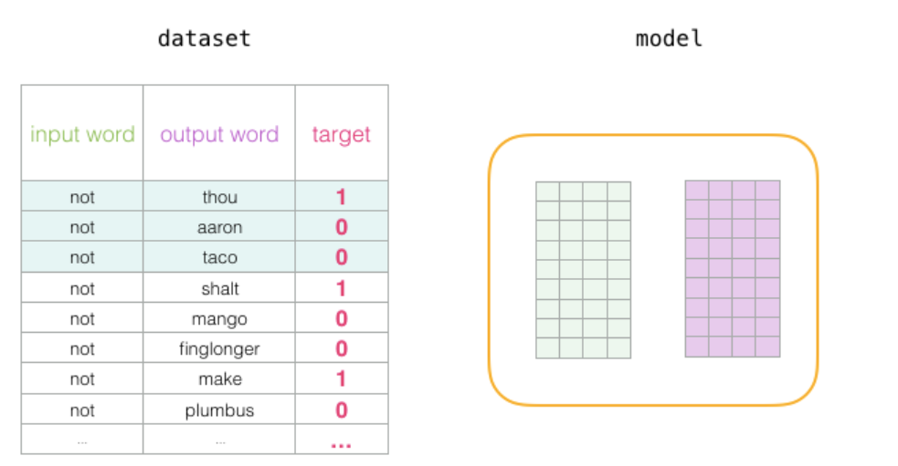
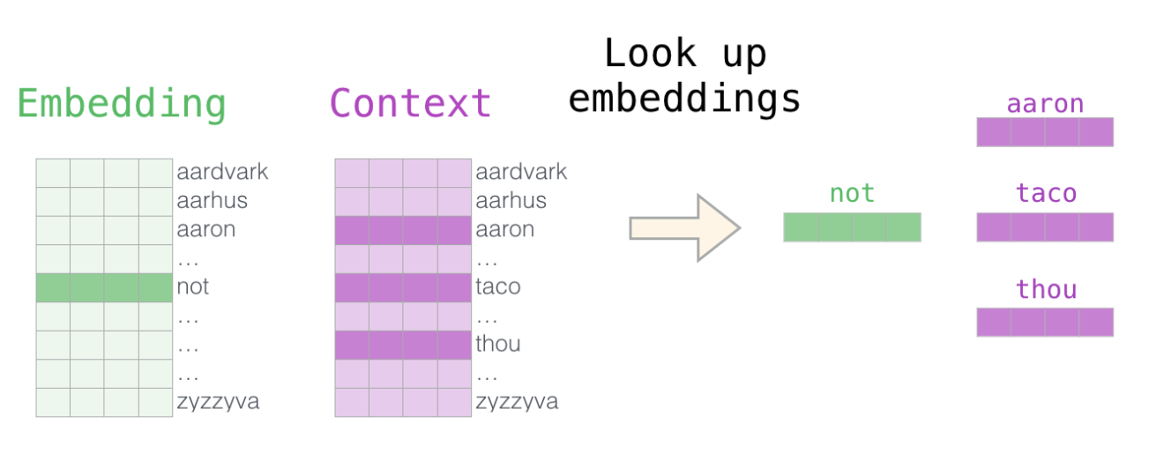
Word2vec Training Process
Consider 2 Matrix, Embedding & Context , we initialize these matrices
with random values
In each training step, we take one positive example and its associated
negative examples
Look up for embeddings

Slide 17
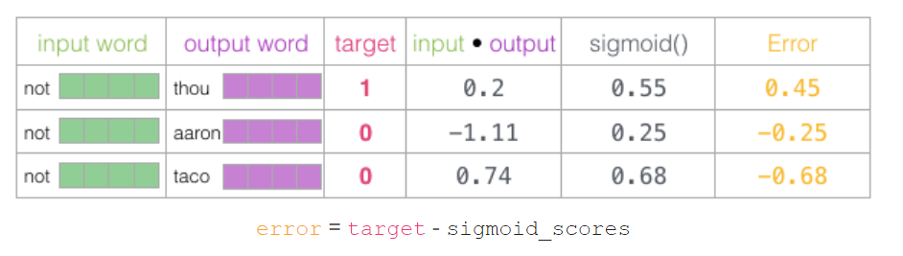
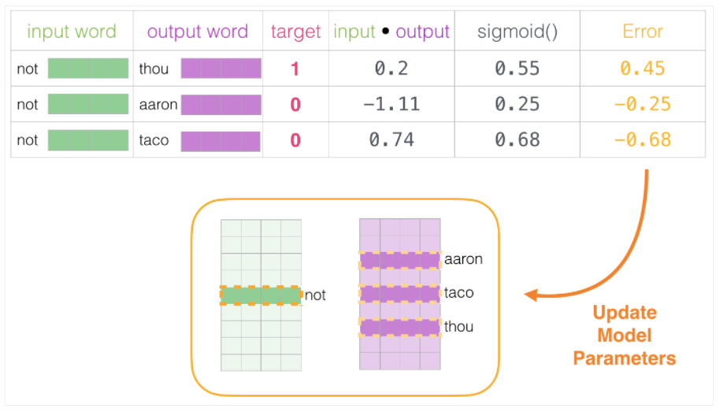
Word2vec Training Process
Simply take dot product of the Embedding and Context vector, and pass it through sigmoid function to calculate value between 0 and 1
Use this error score to adjust the embeddings of not, thou, aaron, and taco so that the next time we make this calculation, the result would be closer to the target scores.

Slide 18
ELMO
ELMo is a novel way to represent words in vectors or embeddings.
If word “stick” is present in our dataset ,it would be represented by same vector no-matter what the context was.
Ideally word “stick” should have multiple meanings depending on where it’s used.
Why not give it an embedding based on the context it’s used in – to both capture the word meaning in that context as well as other contextual information?
Instead of using a fixed embedding for each word, ELMo looks at the entire sentence before assigning each word in it an embedding.
It uses a bi-directional LSTM trained on a specific task to be able to create those embeddings.

Slide 19
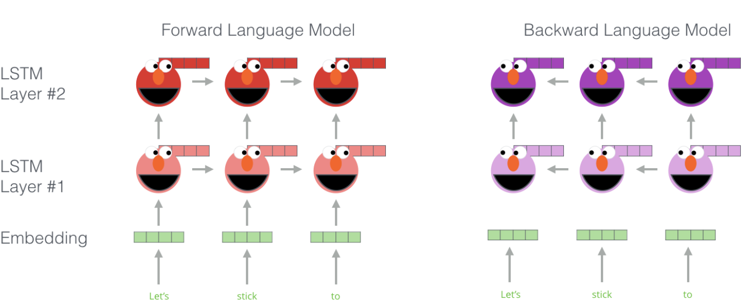
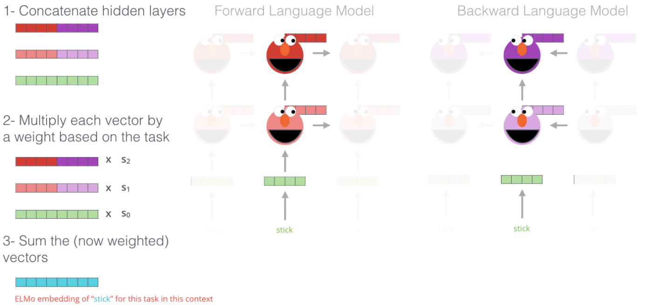
ELMO
ELMo gained its language understanding from being trained to predict the next word in a sequence of words - a task called Language Modeling
Step1 : Create context-based embedding for stick, by training Language Modeling
Step2: ELMo comes up with the contextualized embedding through
grouping together the hidden states (and initial embedding) in a certain
way (concatenation followed by weighted summation).

Slide 20
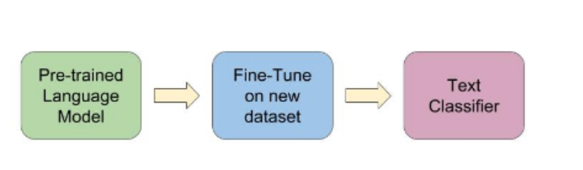
ULMFIT: Nailing down Transfer Learning in NLP
ULM-FiT introduced methods to effectively utilize a lot of what the model learns during pre-training – more than just embeddings, and more than contextualized embeddings
It introduced a language model and a process to effectively fine-tune that language model for various tasks.
NLP finally had a way to do transfer learning probably as well as Computer Vision could.

